Slide 1
Feature subset selection using Information Theoretic Metrics
Prof.Aruna Malapati

Slide 2
Learning Objectives
Define Entropy and Mutual Information

Slide 3
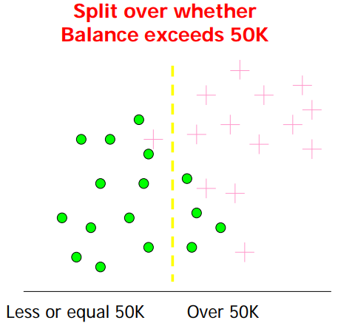
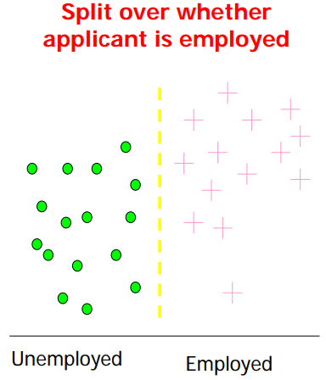
Information Theoretic approaches for Feature selection
Which test is more informative?
Information-theoretic concepts can only be applied to discrete variables.
Notes:
most information-theoretic concepts can only be applied to discrete variables. Therefore, feature selection algorithms in this family can only work with discrete data. For continuous feature values, some data discretization techniques are required beforehand.
MI is capable of measuring a general dependence between two features without assuming the distributions of the features

Slide 4
Entropy and Conditional entropy
Entropy: A common way to measure impurity or uncertainty

Slide 5
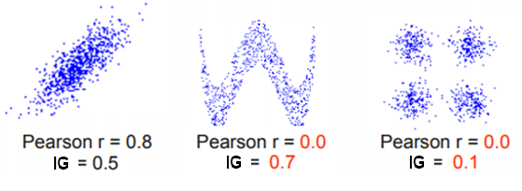
Information Gain
Information Gain IG(X;Y) is a measure of the mutual independence between two random variables X and Y.
High
Able to predict Y given X
Information Gain
IG(X;Y)
Low
Hard to predict Y given X
Symmetric I(X,Y) = I(Y,X)
Measures non-linear dependencies
I(X;Y)=0 if X and Y are independent
Biased towards the features having large
number of values
Notes:
MIFS selects a feature subset with a size of k which maximizes the Mutual Information (MI) between the features and the target variable
https://www.dwavesys.com/sites/default/files/qubits2018_mifs_ver2.pdf
We want to determine which attribute in a given set of training feature vectors is most useful for discriminating between the classes to be learned. • Information gain tells us how important a given attribute of the feature vectors is.

Slide 6
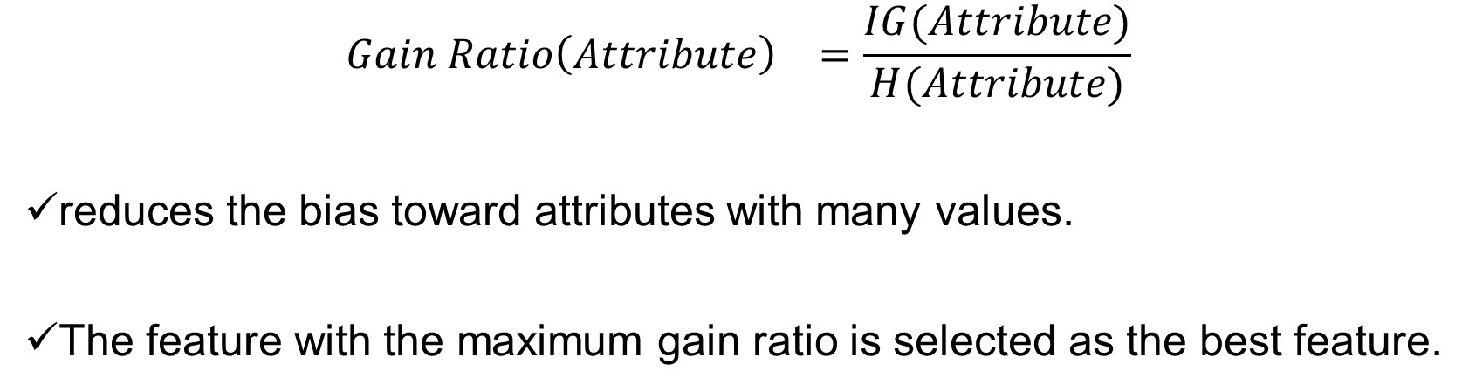
Gain Ratio
The gain ratio “normalizes” the information gain
$${Gain Ratio\left(Attribute\right)}^{}=\frac{IG(Attribute)}{H(Attribute)}$$
reduces the bias toward attributes with many values.
The feature with the maximum gain ratio is selected as the best feature.
Notes:
The information gain ratio is a variant of the mutual information.
It can be seen as a normalization of the mutual information values from 0 to 1. It is the ratio of information to the entropy of the target attribute. By doing so, it also reduces the bias toward attributes with many values.
❖ Gain ratio: a modification of the information gain that reduces its bias  Gain ratio takes number and size of branches into account when choosing an attribute  It corrects the information gain by taking the intrinsic information of a split into account  Intrinsic information: entropy of distribution of instances into branches (i.e. how much info do we need to tell which branch an instance belongs to)
The information gain ratio is a variant of the mutual information. It can be seen as a normalization of the mutual information values from 0 to 1. It is the ratio of information to the entropy of the target attribute. By doing so, it also reduces the bias toward attributes with many values. There exists several versions of the definition of this measure. Especially, there exists an asymmetric and a symmetric version.

Slide 7
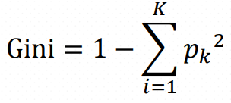
Gini Index
Gini index minimize the probability of misclassification
where 𝑝_{𝑘} denotes the proportion of instances belonging to class 𝑘 𝐾 = 1, … , 𝑘.
High
Able to predict Y given X
Gini Index
(X;Y)
Low
Hard to predict Y given X
Notes:
CART (Classification and Regression Tree)

Slide 8
Example
ATTRIBUTES |  |  |  | CLASS LABEL
Gender | CAR Ownership | Travel Cost(Rs/Km) | Income Level | Transport Mode
Male | 0 | Cheap | Low | Bus
Male | 1 | Cheap | Medium | Bus
Female | 0 | Cheap | Low | Bus
Male | 1 | Cheap | Medium | Bus
Female | 1 | Expensive | High | Car
Male | 2 | Expensive | Medium | Car
Female | 2 | Expensive | High | Car
Female | 1 | Cheap | Medium | Train
Male | 0 | Standard | Medium | Train
Female | 1 | Standard | Medium | Train
Transport Mode
Bus | Train | Car
4 | 3 | 3
H(Transport Mode) = H(4,3,3)
= – (4/10 log₂ 4/10) – (3/10 log₂ 3/10)
– (3/10 log₂ 3/10)
= 1.571

Slide 9
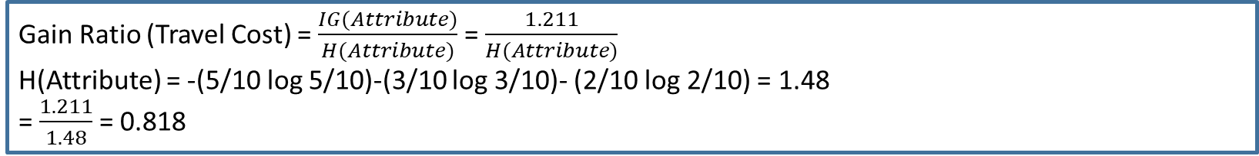
Example (Contd..)
 | Class Label
Attribute values |  | Bus | Train | Car
 | Cheap | 4 | 1 | 0
 | Expensive | 0 | 0 | 3
 | Standard | 0 | 2 | 0
H(Transport Mode)= 1.571
IG(Transport Mode, Travel Cost) = H(Transport Mode)-H(Transport Mode| Travel Cost)
= 1.571 - H(4,3,2)
= 1.571 - (-5/10 (4/5 log 4/5 +1/5log1/5) - (3/10 (3/3 log 3/3 + 0 log 0)) - (3/10 (2/2 log 2/2 + 0 log 0)))
= 1.571 – 0.36 = 1.211
Gain Ratio (Travel Cost) = $\frac{IG(Attribute)}{H(Attribute)}$ = $\frac{1.211}{H(Attribute)}$
H(Attribute) = -(5/10 log 5/10)-(3/10 log 3/10)- (2/10 log 2/10) = 1.48
= $\frac{1.211}{1.48}$ = 0.818
Gini Index(Transport Mode,|Travel Cost=cheap) = 1-(0.8²+0.2²) = 0.32
Gini Index(Transport Mode,|Travel Cost=Expensive) = 1-(1²+0²)=0
Gini Index(Transport Mode,|Travel Cost=Standard) = 1-(1²+0²)=0
Gini Index(Transport Mode,|Travel Cost=cheap) = 5/10*0.32+3/10*0+2/10*0 = 0.16

Slide 10
Example (Contd..)
 | Information Gain | Gain Ratio | Gini
Gender | 0.147 | 0.147 | 0.6
Car Ownership | 0.544 | 0.368 | 0.453
Travel Cost | 1.21 | 0.818 | 0.16
Income Level | 0.696 | 0.458 | 0.366

Slide 11
Thank You!
In our next session: Feature subset selection using Fisher Score

